Slide 1
Recognizing Stroke FAST: Face Arms Speech Time
Notes:
What is FAST? Broad overview.

Slide 2
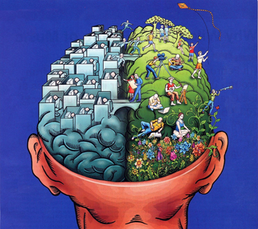
You and Your Brain
Your brain:
Helps you to understand information from your senses
Responsible for thinking, remembering, understanding, planning, reasoning and problem-solving
Notes:
Your brain interprets what you see. It also allows you to speak and understand.

Slide 3
Your Brain
One of the largest and most complex organs in your body
Made up of more than 100 billion nerves
All parts of the brain must work together to keep you functioning properly

Slide 4
FAST Stroke Facts
Stroke is a “brain attack”
Stroke can happen to anyone, at any age, and at anytime
Two million brain cells die every minute during a stroke
Stroke is the 5th leading cause of death in the U.S. (3rd cause of death in women)
Leading cause of adult disability
Notes:
Transition from brain into stroke- a brain attack

Slide 5
FAST Stroke Facts
About 55,000 more women than men have a stroke each year
African-Americans are twice as likely as whites to have a first-time stroke
80% of strokes are preventable (lifestyle changes)
Medical options exist that may reduce the effects of stroke is administered soon after the onset of symptoms
Notes:
Why should people care/be aware of stroke?

Slide 6
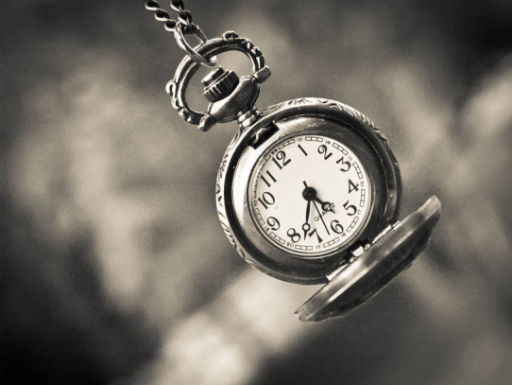
What is a Stroke?
A stroke occurs when one of the blood vessels that carry blood to the brain is blocked or bursts
That part of the brain does not get the blood that it needs causing brain cells to die
Stroke is an emergency! Act FAST and call 9-1-1 IMMEDIATELY!
Notes:
Explanation of stroke

Slide 7
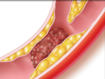
Types of Stroke – Ischemic Stroke
Most common type of stroke
Occurs when arteries are blocked by blood clots or by the gradual build-up of plaque and other fatty deposits
88% percent of strokes are ischemic
Notes:
Types of stroke

Slide 8
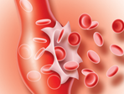
Types of Stroke – Hemorrhagic Stroke
Occurs when a blood vessel in the brain breaks, leaking blood into the brain
13% of strokes are hemorrhagic
Responsible for more than 30% of all stroke deaths
Notes:
Hemorrhagic stroke is also knows as bleeding stroke.

Slide 9
Why Learn FAST?
To save lives
Easy to remember
Easy to teach
Requires quick action
Notes:
Let the audience know why you are talking about FAST. Why is this important to them?

Slide 10
FAST
FACE: Ask the person to smile. Does one side of the face droop?
ARMS: Ask the person to raise both arms. Does one arm drift downward?
SPEECH: Ask the person to repeat a simple phase. Is their speech slurred or strange?
TIME: If you observe any of these signs – call 9-1-1 IMMEDIATELY!
Notes:
How to know if you or someone you know is having a stroke. Signs and symptoms of stroke

Slide 11
Other Symptoms of Stroke (Suddens)
Numbness or weakness of the face, arm or leg, especially on one side of the body
Confusion, trouble speaking or understanding
Trouble seeing in one or both eyes
Trouble walking, dizziness or loss of balance
Severe headache with no known cause
Notes:
Other possible signs of stroke

Slide 12
Act FAST
If you experience one or more of these symptoms or notice them in someone else, even for a short time, call 9-1-1
Medical options exist that may reduce the effects of stroke
- Time is of importance, as treatment must be
administered soon after the onset of symptoms
Stroke strikes FAST. You should too!
Notes:
Treatment must be given quickly in order to be helpful.

Slide 13
Transient Ischemic Attack (TIA)
An episode, sometimes called a mini-stroke
Symptoms can be temporary or may come and go
TIA generally does not cause permanent brain damage
TIA can be a serious warning sign of stroke and should not be ignored
Symptoms of TIA and stroke are basically the same
Notes:
Mini Stroke

Slide 14
Effects of Stroke
The effects of stroke depend on various factors:
The region of the brain that was affected
The size of the area that was damaged by the stroke
The functions that the damaged area controlled
Notes:
What may happen to you if you do have a stroke.

Slide 15
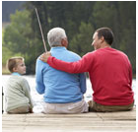
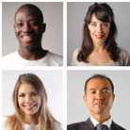
Risk factors that cannot be controlled
Age: while strokes can occur at any age, most risk increases over 55 years of age
Family History: strokes appear to have have a genetic link; you are at a higher risk if an immediate family member has had a stroke
Race and Ethnicity
Notes:
How to know if you are at risk. Uncontrollable risk factors.

Slide 16
Risk factors that cannot be controlled
Gender: women have a lower risk than men before menopause; but, more women than men die of stroke
Prior Stroke or TIA: 5 to 14% of the people who had a prior stroke are more likely to have another stroke within 5 years of the first stroke
Notes:
Uncontrollable risk factors

Slide 17
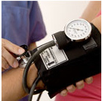
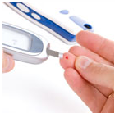
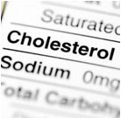
Medical Risk Factors
High Blood Pressure: people who have high blood pressure have 1 ½ times the risk of having a stroke than people who do not have high blood pressure
Diabetes: people with diabetes are up to 4 times as likely to have a stroke. High blood glucose increases plaque build up in your arteries
Cholesterol: buildup of fatty deposits and other cells in artery walls
Notes:
Controllable risk factors

Slide 18
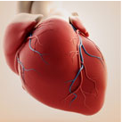
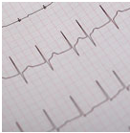
Medical Risk Factors
Circulation Problems: strokes can be caused by blockage in your arteries and veins that carry blood through your heart to your brain
Atrial fibrillation (Afib): about 15% of all people who have strokes have afib
Notes:
Controllable RFs.

Slide 19
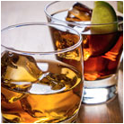
Lifestyle Risk Factors
Quit Tobacco Use and Smoking: smoking doubles the risk for stroke when compared to nonsmokers
Eliminate or Reduce Alcohol Use: increased alcohol use may increase stroke risk by 50%
Notes:
Controllable risk factors. What you CAN do to lower your risk.

Slide 20
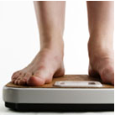
Lifestyle Risk Factors
Increase Physical Activity: physical activity can help reduce stroke risk; a brisk 30 minute walk day can improve daily health (that is just 15 minutes each way!)
Maintain a Healthy Weight: obesity and excessive weight can put a strain on the entire circulatory system
Notes:
Controllable risk factors.

Slide 21
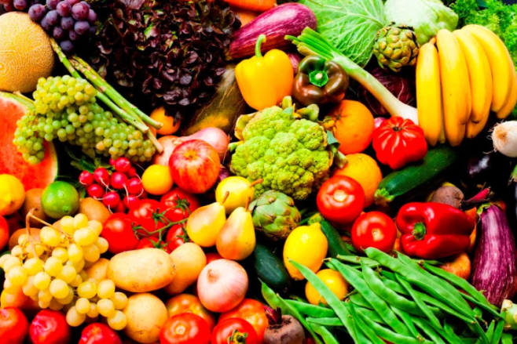
Lifestyle Risk Factors
Eat a Healthy Diet:
Rich in fresh fruit and vegetables
Limit salt intake
Avoid fried foods
Avoid snacking
Notes:
Controllable risk factors. Making just one change will make s difference.

Slide 22
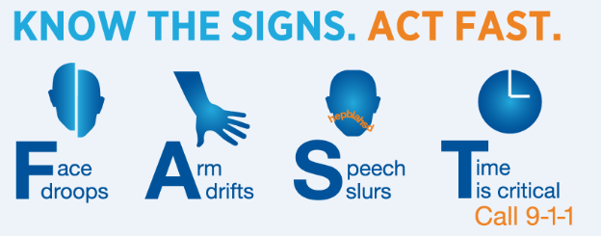
FAST
Think and act FAST to save a life
Call 9-1-1 IMMEDIATELY
Improve survival and recovery

Slide 23
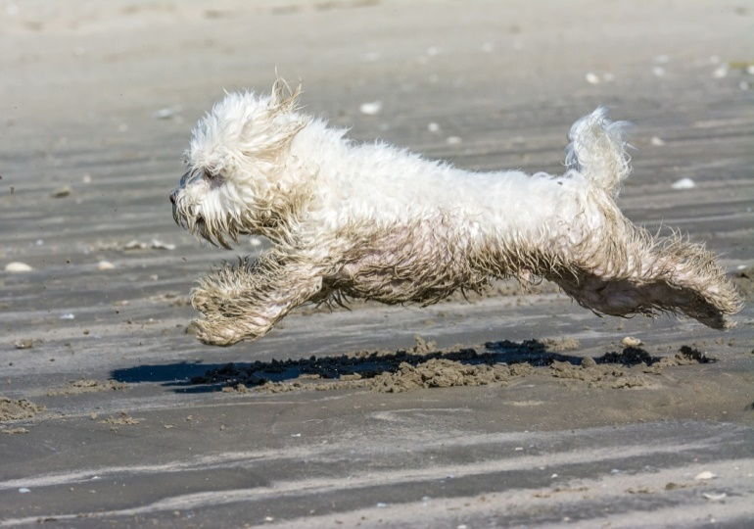
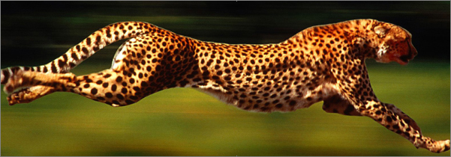
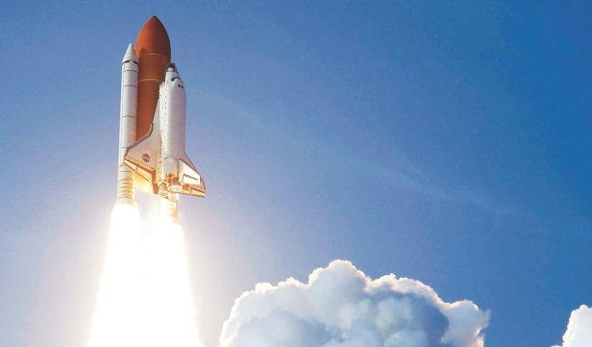
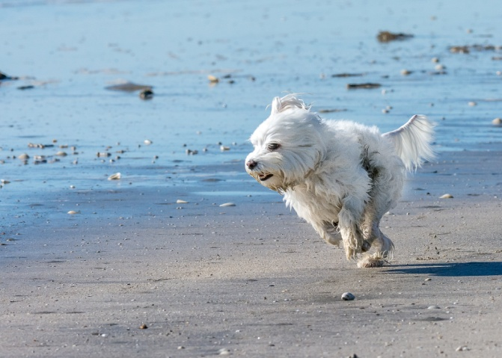
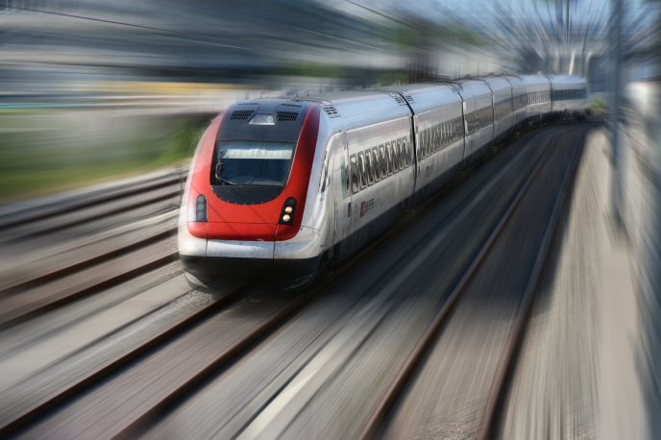
What do these pictures have in common?
FAST
Notes:
The key to successful patient outcomes is fast recognition and treatment of people suffering a stroke

Slide 24
Why Teach FAST?
The medical team can act fast
Once you reach the hospital the team will determine what type of stroke it is
If you are diagnosed with a stroke caused by a blood clot you may receive treatment
The medication can only be given soon after the onset of symptoms
Notes:
Tie this back to the beginning as to why it was discussed and possible treatment.

Slide 25
Discussion Questions
Do you know someone who has survived a stroke?
How can you recognize stroke when it happens?
Why is timing so important when responding to and treating stroke?
What percentage of strokes can be prevented?
Which medical conditions should be treated in order to reduce the risk of stroke?
What types of small changes can you implement in your life to reduce your risk for primary or secondary stroke?

Slide 26
For more information visit
www.stroke.org

